Slide 1
Bitcoin Closing Rate – Machine_Learning Project
Mor yossef & Rinat polonski

Slide 2
Bitcoin
Bitcoin is a decentralized digital currency, without a central bank or single administrator, that can be sent from user to user on the peer-to-peer bitcoin network without the need for intermediaries.
The cryptocurrency was invented in 2008 by an unknown person or group of people. The currency began to use in 2009 when its implementation was released as open-source software.
Our research question is trying to predict the future rate of Bitcoin currency based on the multiple parameters we found over the years.
Research Question

Slide 3
Project’s Main Steps
Data-Acquisition
Web crawling and API for collecting and obtaining the data
Data Cleaning
Cleaning, formatting, and filtering the data.
EDA
Machine Learning
Visualizing and understanding the data
Create final predict model

Slide 4
Data Sources
API
Google Trends
Twitter’s Tweets
Crawling (selenium)
https://nomics.com/assets/btc-bitcoin/history

Slide 5

Selenium
Selenium is an open-source project for a range of tools and libraries aimed at supporting web browser automation. Selenium provides a playback tool for authoring functional tests without the need to learn a test scripting language .
It supports provides all popular programming languages: including JavaScript, C#, Groovy, Java, Perl, PHP, Python.
The tests can then run against most modern web browsers.
Selenium runs on Windows, Linux, and macOS. It is open-source software released under the Apache License 2.0.
We used in our project python and chrome browser.

Slide 6
Crawling
Using Selenium we performed the crawling stage to the site.
The site keeps data about Bitcoin and other well-known coins history.
We took the relevant columns for our project : DATE, OPEN, HIGH, LOW, CLOSE, VOLUME.
The data begin in 2011 till today.
Finally, the records are saved into CSV for working with Data Frame.

Slide 7
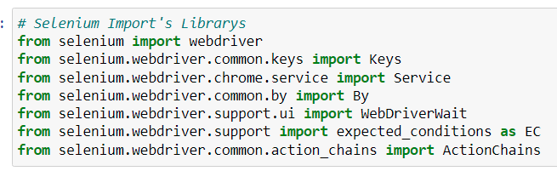
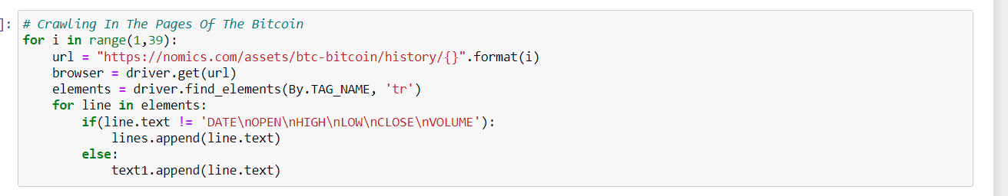
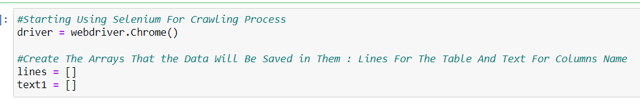
Crawling

Slide 8
Not everything was so easy…
At the beginning we tried using ‘Beautiful Soup’ library but we couldn’t get the relevant data because we were dealing with dynamic websites.
We looked for different crawling tool which can deal with dynamic sites. After Research, we decided to use selenium instated.

Slide 9
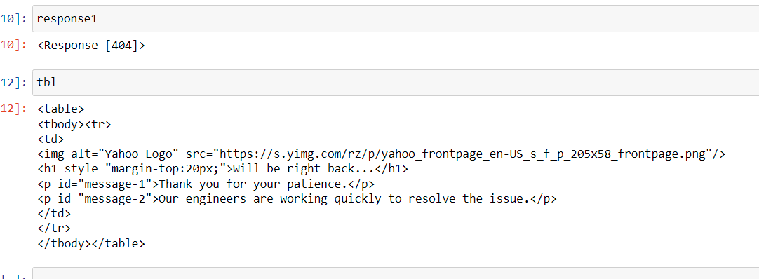
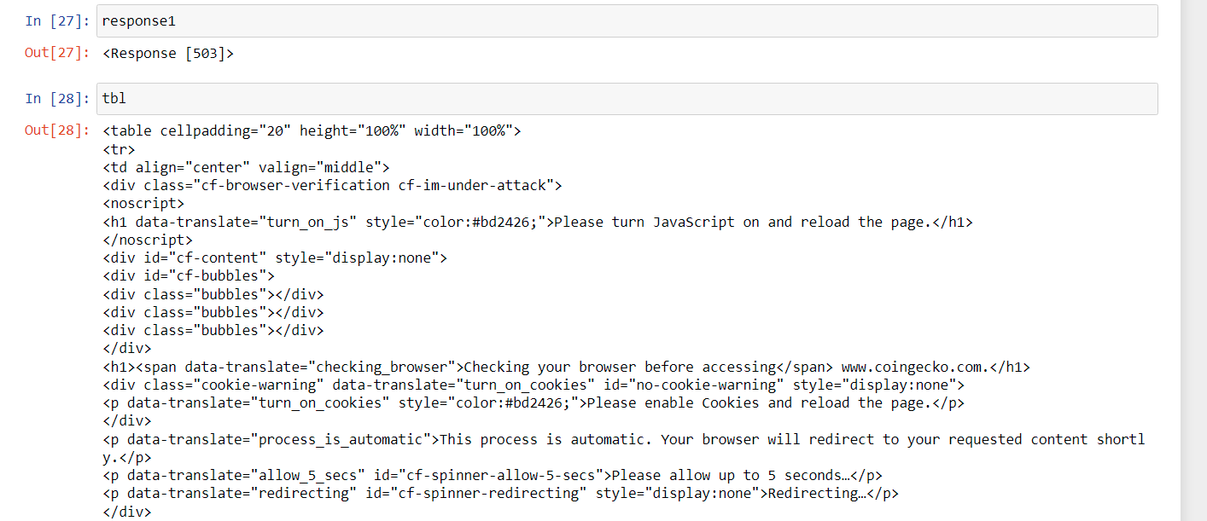

Slide 10
Cleaning the data
“Up|Down” – We converted the categorical column to binary parameter.
Change (%) – We added percent column for the changing in the closing rate column.
Date – We changed the original dates we got from the site to the same twitter format.
Outliers – Our data is based on time series so we are looking for outliers using %.
Null – Search for missing data.
Cleaning – We deleted columns which didn’t help for the machine Learning stages.

Slide 11
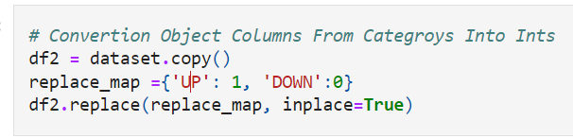
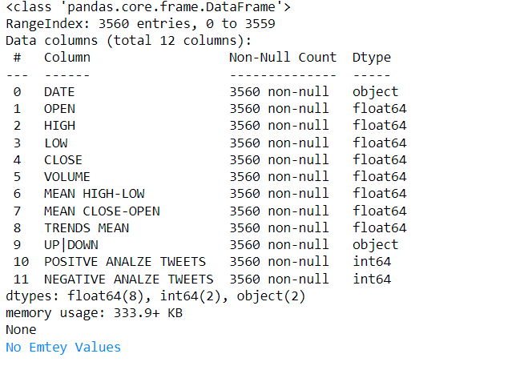
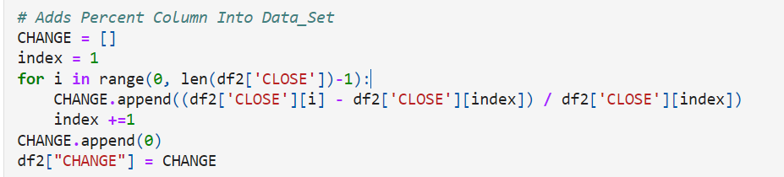
Category Column Into 0/1
Missing Cells
Add Percent (%)

Slide 12
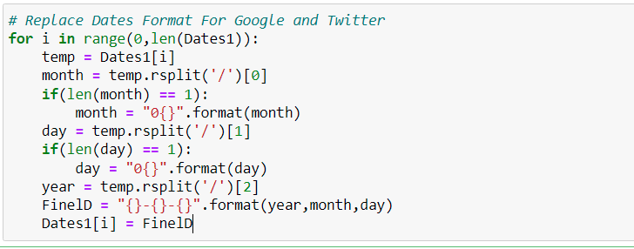
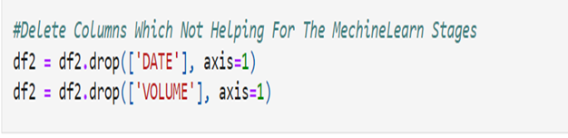
Date Formatting
Delete Columns

Slide 13
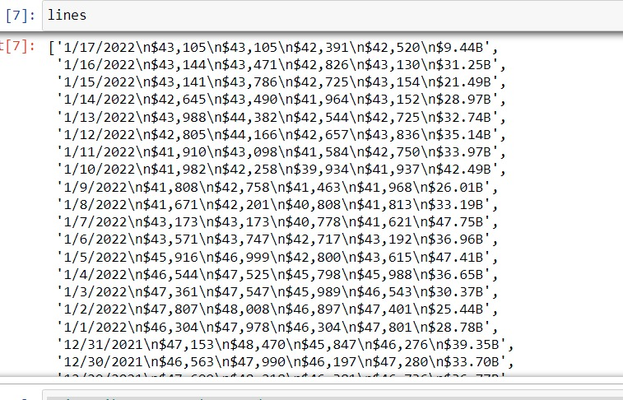
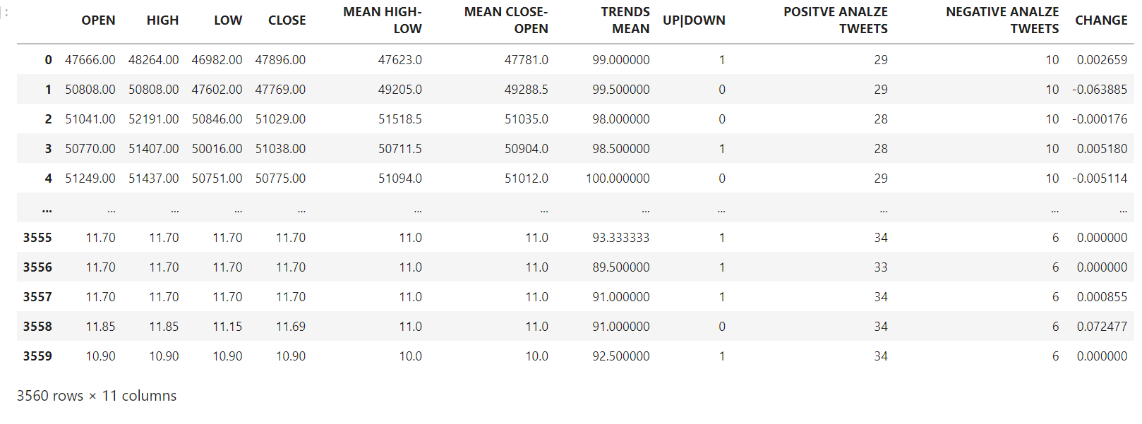
cleaning not relevant columns
After cleaning date & volume

Slide 14
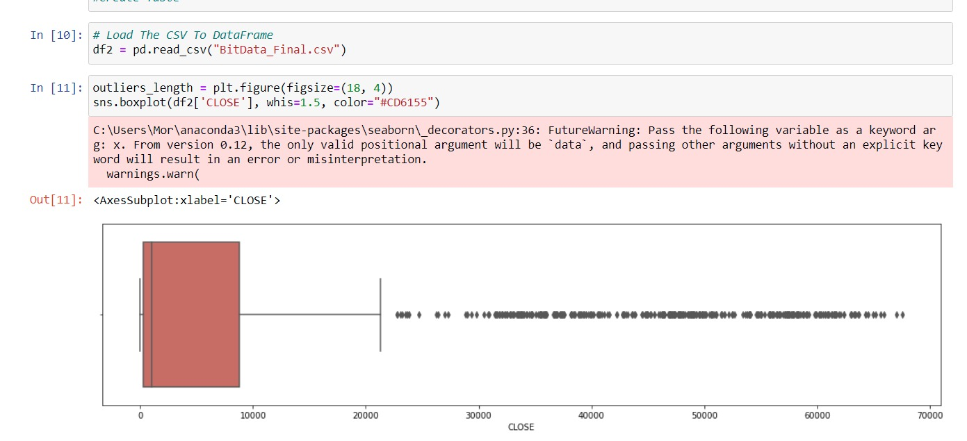
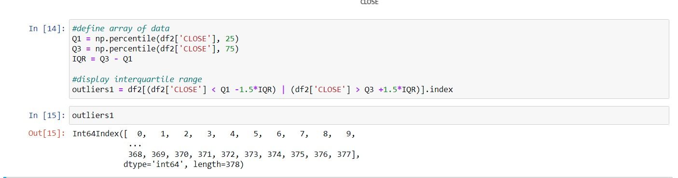
Working with Outliers – Problem

Slide 15
Outliers – Dropping

Slide 16
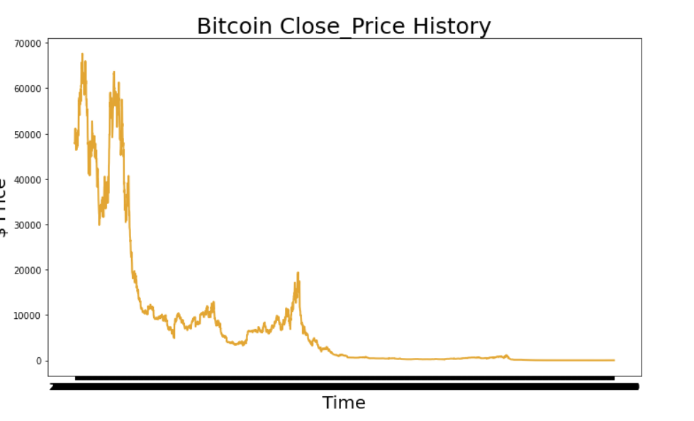
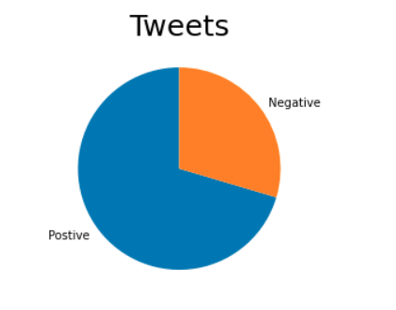
Visualization Stage

Slide 17
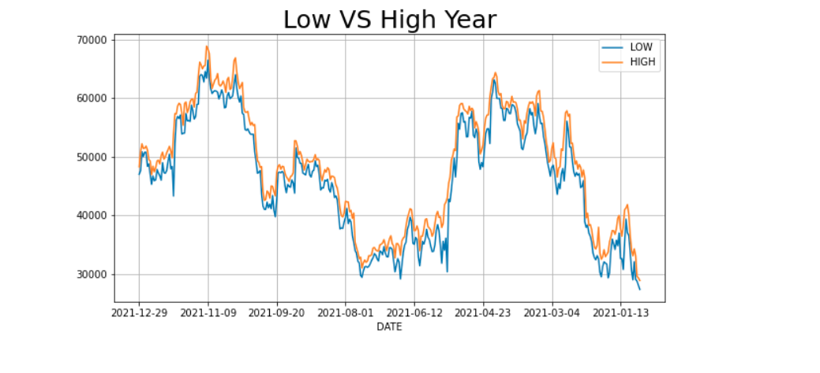

Slide 18
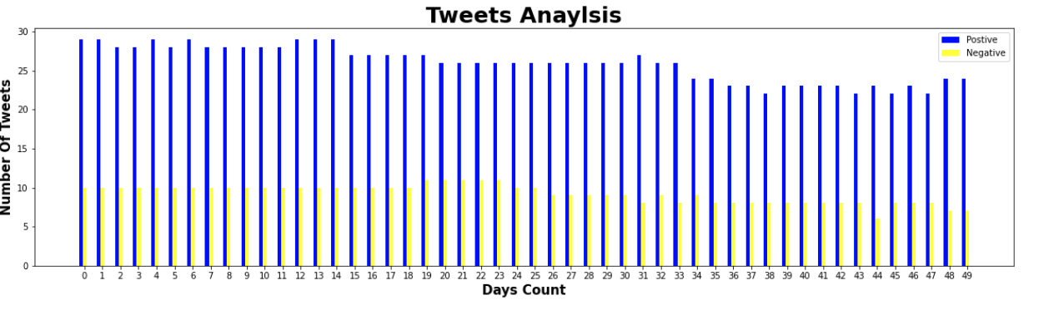
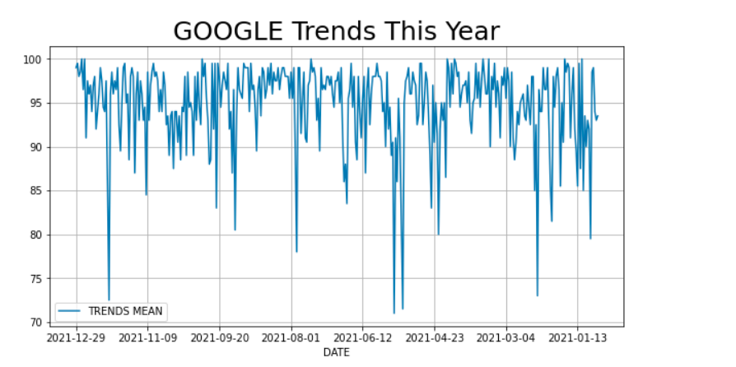

Slide 19
What we learn

Slide 21
Thank you for listening.

